Slide 1
LITERATURE SURVEY
TEAM NO :10
PROJECT TITLE: E-COMMERCE MARKETING SPEND OPTIMIZATION
TEAM MEMBERS:
DHANYA SS 20BCS027
HARISHINI S 20BCS037
KANISSHA P P 20BCS047
KASHIKA M 20BCS052
KEERTHIKA S 20BCS054
Faculty Name
V.SENTHIL KUMAR AP II/CSE
Kumaraguru College of Technology/
Coimbatore
Engineering Clinic V
Sem V |CSE | Kumaraguru College of Technology

Slide 2
PRESENTATION OUTLINE
TEAM NO :10
Literature Survey
Inference
Problem Statement
Dataset Used
Block diagram for Proposed System
Front End & Back End
Timeline using Gantt chart
References
Kumaraguru College of Technology/
Coimbatore
Engineering Clinic V
Sem V |CSE | Kumaraguru College of Technology

Slide 3
Literature Survey TITLE AND AUTHOR | Problem Statement: | Effectively uses e-commerce information to maintain and enhance the emotional bond between stores and consumers, while avoiding open confrontation with competitors, and explore more refined database marketing application strategies of e-commerce
Title: Research on E-Commerce Database Marketing Based on Machine Learning Algorithm Author: Nie Chen(2022) | Proposed Solution: | Customer type Classification Algorithms - Logistic regression, Random forest, support vector machine, and GBDT
 | Output: | On the classification Algorithm GBDT (gradient lifting decision tree)has proved to be better than other algorithms
 | Merits: | If the number of features is too much, it is easy to overfit and train the model for too long
 | Demerits: | Selection of characteristic variables is difficult: If the number of feature variables is too small, the classification characteristics are not obvious, and the classification effect will be reduced
 | Future Scope: | Need further research in : Need to in-depth understanding of e-commerce database marketing status Improve feature construction from multiple perspectives based on e-commerce practical experience

Slide 4
Literature Survey TITLE AND AUTHOR | Problem Statement: | For merchants and e-commerce companies, the increase of click-through rate (CTR) can be considered as an indicator of an increase of revenue. Therefore, much attention has been paid to creative design for improving the visual experience of advertisements.
Title: Automated Creative Optimization for E-Commerce Advertising Author: Jin Chen, Ju Xu, Gangwei Jiang, Tiezheng Ge, Zhiqiang Zhang, Defu Lian, and Kai Zheng. 2021. | Proposed Solution: | The proposed solution framework consists of the following phases: (1) CTR Estimation using efficient search strategy: -One-Shot Search Algorithm -Operation-aware Embedding (2) Efficient exploration via thompson sampling
 | Output: | An automated creative optimization framework to model complex interaction between creative elements and to strike a balance between exploration and exploitation
 | Merits: | Both offline and online experiments, showing that our proposed approach performs better than the competing baselines and verifying the effectiveness of the proposed algorithms.
 | Demerits: | -
 | Future Scope: | Automated creative optimization of advertisements help to promote any company or a product in effective manner based on the previous sales or preference data

Slide 5
Literature Survey TITLE AND AUTHOR | Problem Statement: | Usage of ecommerce effectively in agricultural product marketing which reduces the difficulties encountered by the customers
Title: E-Commerce Marketing optimization of Agricultural Products Based on Deep learning and data mining Author: Hui yang, Zhuohang Zheng , and hu Sun | Proposed Solution: | Creation of sales prediction model –super crown model (SICM) of deep learning ,and application of data mining technology in the field of ecommerce to promote the transformation of marketing optimization.
 | Output: | The convenience of ecommerce of agricultural products can stimulate customers to consume and further increase the sales of rural online stores. The Case analysis, and data analysis puts forward an optimization scheme of ecommerce agricultural products based on deep learning and data mining.
 | Merits: | The SICM model is more flexible and the data used to support the findings of the study upon author request
 | Demerits: | Classification of data is difficult for the big data.
 | Future Scope: | Online selling and purchasing offer innumerable benefits to both sellers and buyers, and these advantages are also the reasons for the rising scope of eCommerce. address notable challenges and inefficiencies in the agriculture supply chain by streamlining farmers' access to the customer and creating new links between steps in the value chain.

Slide 6
Literature Survey TITLE AND AUTHOR | Problem Statement: | Focus on the performance-based advertising by specifying the maximum daily amount they are willing to pay and get the audience through various pages in E-commerce platform.
Title: Optimal Delivery with Budget Constraint in E-Commerce Advertising Author: Chao Wei, Weiru Zhang Shengjie Sun Fei Li Xiaonan Meng | Proposed Solution: | Linear Programming Simulation System Auction
 | Output: | Linear programming to optimize overall revenue of the platform and improve different performance goals can be implemented in both display and search advertising. Simulation system to evaluate the results of different allocation plans by replaying auction from online requests. Conjunction with pricing and ranking schemes it can effectively improve both revenue and various performance goals.
 | Merits: | Linear Programming provides better insight into business problems and make adjustments according to changing conditions
 | Demerits: | Working with real time data seems difficult
 | Future Scope: | Focus on incorporating real-time data into the problem setup to improve accuracy. The offline simulation system needs to be improved

Slide 7
Literature Survey TITLE AND AUTHOR | Problem Statement: | Using the suitable machine learning algorithm to predict the consumer preference towards a particular product and the methodology to retarget them for future advertisement
Title: A Comparison and Interpretation of Machine Learning Algorithm for the Prediction of Online Purchase Conversion Author: Lee, J.; Jung, O.; Lee, Y.; Kim, O.; Park | Proposed Solution: | XGB model for predicting online consumers purchase conversion. Applying XGB Explainer from the perspective of individual consumers, to analyse the prediction results of individual consumers by decomposing the contribution of each predictor.
 | Output: | The XGB model is the most suitable machine learning model for predicting online consumers purchase conversion
 | Merits: | The performance of the ensemble model eXtreme Gradient Boosting model is most suitable for predicting purchase conversion of online consumers, and oversampling is the best method to mitigate data imbalance bias
 | Demerits: | Predictive performance decreases in the case of unbalanced data
 | Future Scope: | It is necessary to analyse the effects of machine learning models through field experiments in future studies. In addition, by utilizing causality machine learning, new implications can be provided for machine learning research in the marketing field
Literature Survey
TITLE AND AUTHOR
Problem Statement:
Using the suitable machine learning algorithm to predict the consumer preference towards a particular product and the methodology to retarget them for future advertisement
Title:
A Comparison and Interpretation of Machine Learning Algorithm for the Prediction of Online Purchase Conversion
Author:
Lee, J.; Jung, O.; Lee, Y.; Kim, O.; Park
Proposed Solution:
XGB model for predicting online consumers purchase conversion.
Applying XGB Explainer from the perspective of individual consumers, to analyse the prediction results of individual consumers by decomposing the contribution of each predictor.
Output:
The XGB model is the most suitable machine learning model for predicting online consumers purchase conversion
Merits:
The performance of the ensemble model eXtreme Gradient Boosting model is most suitable for predicting purchase conversion of online consumers, and oversampling is the best method to mitigate data imbalance bias
Demerits:
Predictive performance decreases in the case of unbalanced data
Future Scope:
It is necessary to analyse the effects of machine learning models through field experiments in future studies. In addition, by utilizing causality machine learning, new implications can be provided for machine learning research in the marketing field

Slide 8
Inference From literature Survey
SVM with GBDT can produce better results
Add more features for better prediction
Ensembling algorithm
Suits best for search algorithm
Improve Offline simulation system to validate the algorithm efficiently
Observation from
Literature Review
Increasing efficiency by online and offline datasets
Higher the customer purchase sampling, Higher accuracy of prediction

Slide 9
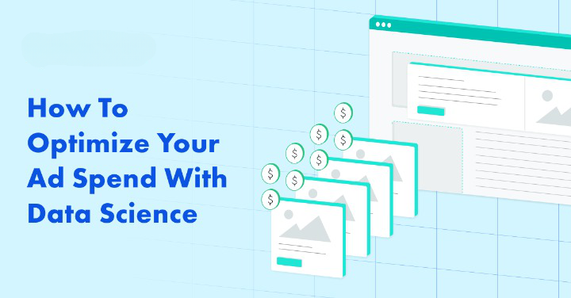
PROBLEM STATEMENT
Generating accurate and reliable sales forecasts is crucial in the E-commerce business nowadays.
E-commerce platform contains large number of related products, in which sales demand patterns in different advertising platforms can be correlated.
Optimization of Budget Allocation for marketing between different platforms of advertisement based on CPC(cost per click), YTD(year to date), indeed the previous dataset.
Accurate forecast can lead to huge savings and cost reduction thereby increasing business profit.

Slide 10
DATASETS
https://github.com/Morphl-AI/Ecommerce-Marketing-Spend-Optimization/blob/master/Datasets/marketing_spend_data.csv
https://www.kaggle.com/datasets/yugagrawal95/sample-media-spends-data

Slide 11
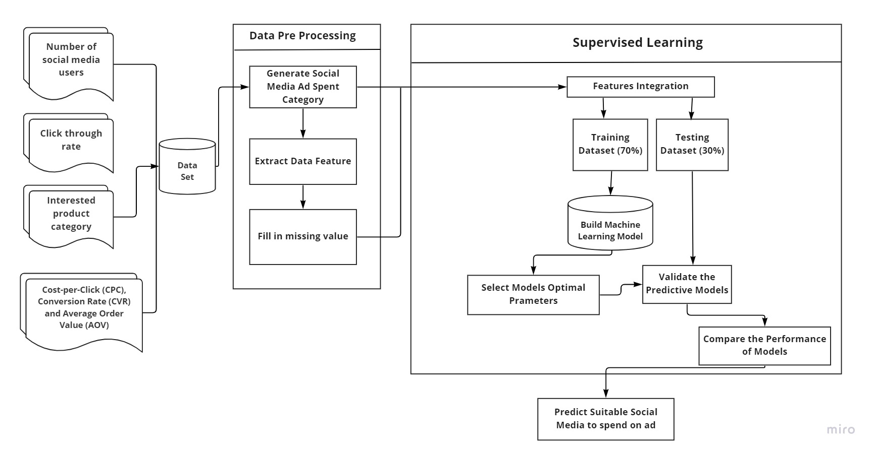
BLOCK DIAGRAM OF PROPOSED SYSTEM
Block diagram link: https://miro.com/app/board/uXjVPUImpuc=/

Slide 12
SYSTEM REQUIREMENTS
Front End
HTML
CSS
Js (Node Js)
Back End
Django
Anaconda Jupyter Notebook (ML model)

Slide 13
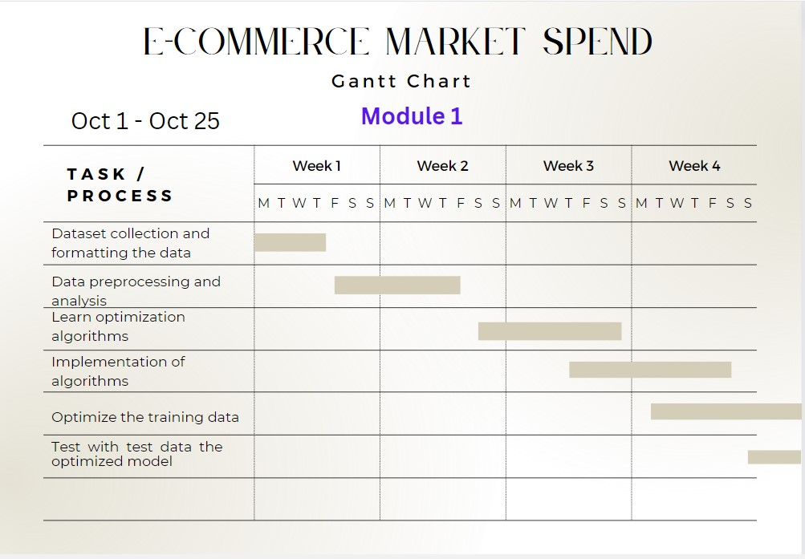
GANTT CHART

Slide 14
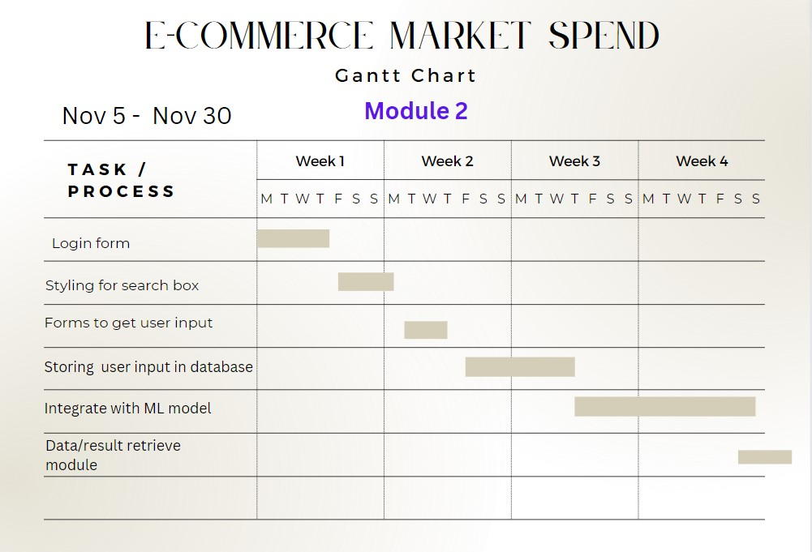
GANTT CHART

Slide 15
REFERENCES
Chen, N., 2022. Research on E-Commerce Database Marketing Based on Machine Learning Algorithm. Computational Intelligence and Neuroscience, 2022
Yang, H., Zheng, Z. and Sun, C., 2022. E-Commerce Marketing Optimization of Agricultural Products Based on Deep Learning and Data Mining. Computational Intelligence and Neuroscience, 2022.
Wei, C., Zhang, W., Sun, S., Li, F., Meng, X., Hu, Y., Lee, K.C. and Wang, H., 2019, October. Optimal Delivery with Budget Constraint in E-Commerce Advertising. In 2nd Workshop on Online Recommender Systems and User Modeling (pp. 46-58). PMLR.
Lee, J., Jung, O., Lee, Y., Kim, O. and Park, C., 2021. A Comparison and Interpretation of Machine Learning Algorithm for the Prediction of Online Purchase Conversion. Journal of Theoretical and Applied Electronic Commerce Research, 16(5), pp.1472-1491.

Slide 16


